Slide 1
A Post-Mortem of the Malicious event-stream backdoor
PWL Atlanta #12
https://www.linkedin.com/in/kevin-w-brown/

Slide 2
Contents
Intro: “I don’t know what to say”
The chase
How did it happen?
What can be done?
Future Talks

Slide 3

I. Intro: “I don’t know what to say”
Notes:
I looked at the security papers and didn’t love them. Ankur suggested post mortem would be acceptable talk

Slide 4
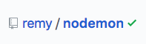
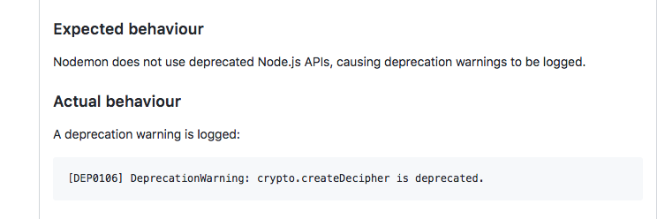
OCT 28
Notes:
On Oct 28 Jayden Seric reported a deprecation warning in nodemon

Slide 5
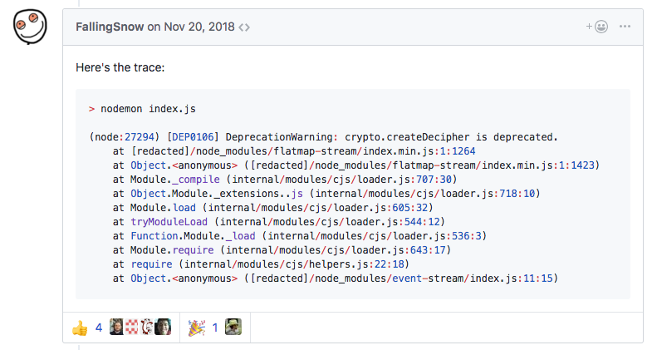

NOV 20
Notes:
On Nov 20 FallingSnow (Ayrton Sparling) posted the stack trace to get the ball rolling

Slide 6

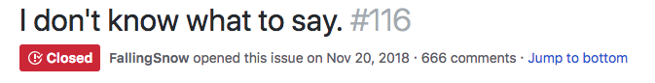
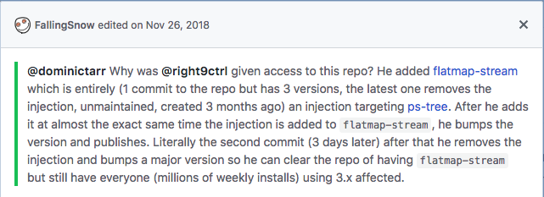
NOV 20
Notes:
And on the same day posted an issue on event-stream. He

Slide 7

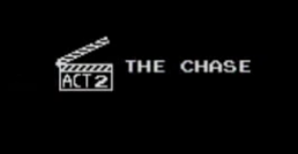

II. The Chase

Slide 8
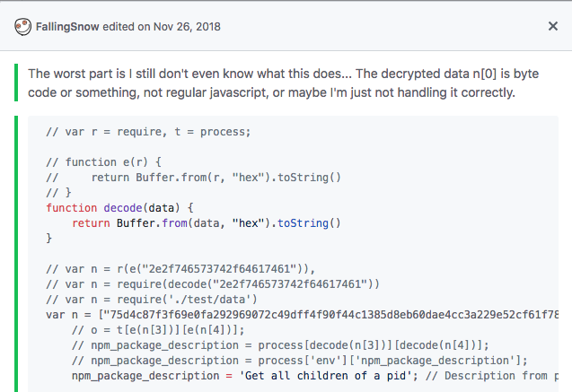
NOV 21

Slide 9
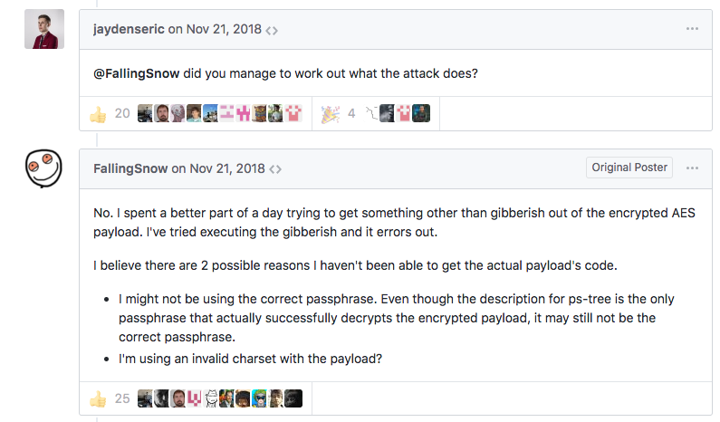
NOV 21

Slide 10
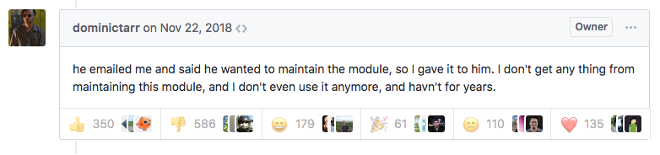
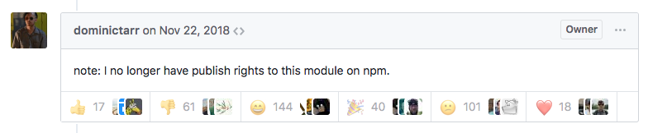
NOV 22

Slide 11
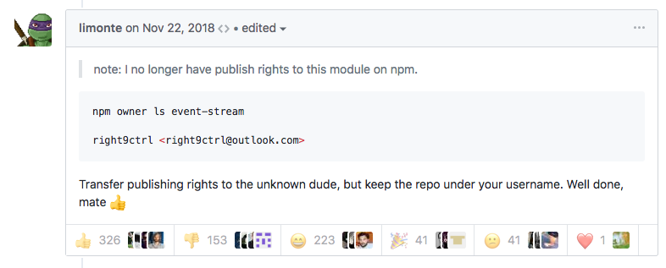
NOV 22

Slide 12
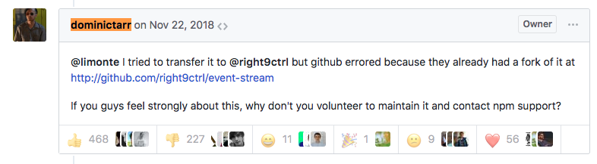
NOV 22

Slide 13
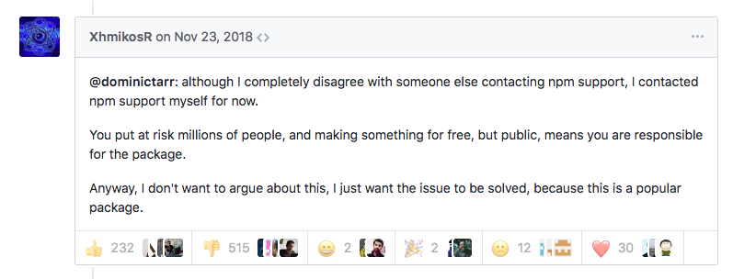
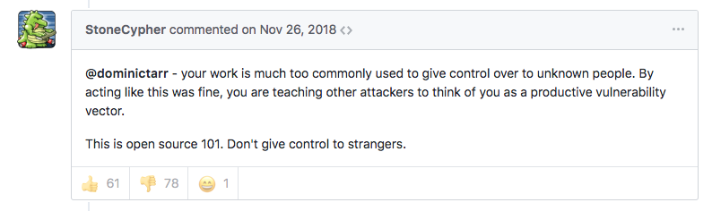
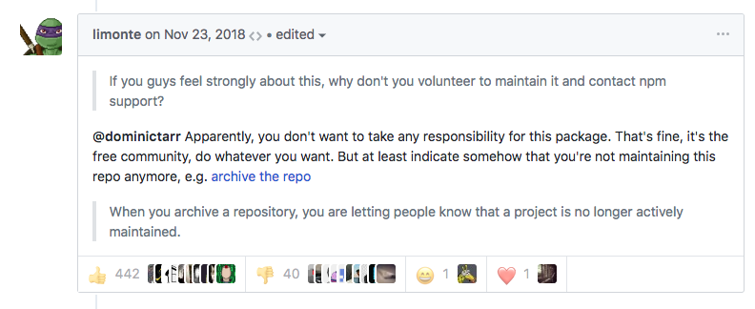
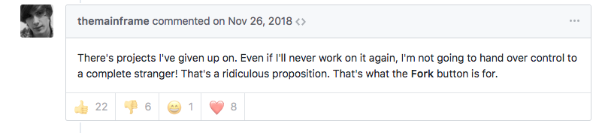
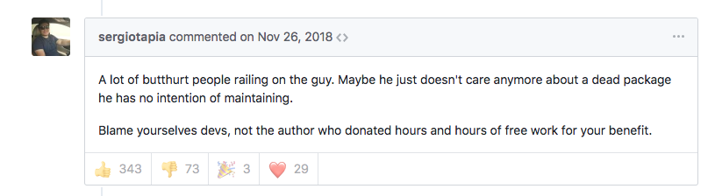
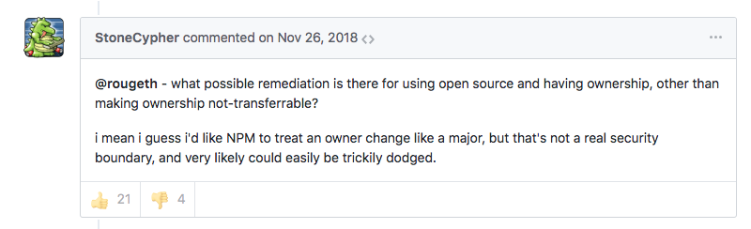
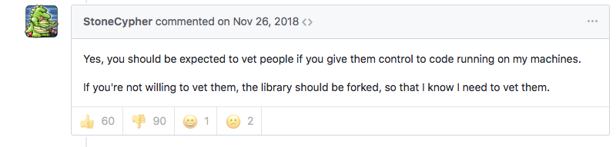
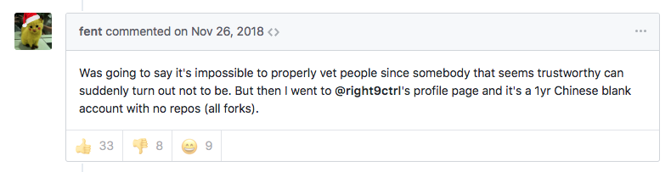
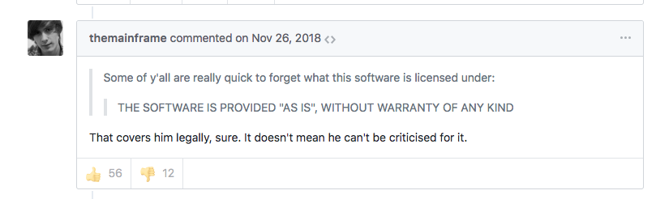
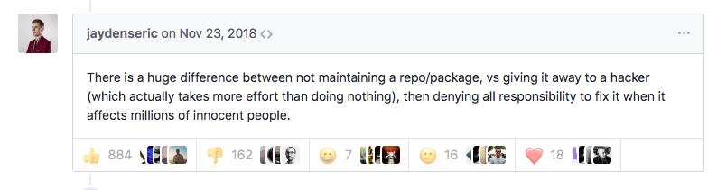
NOV 23-26

Slide 14
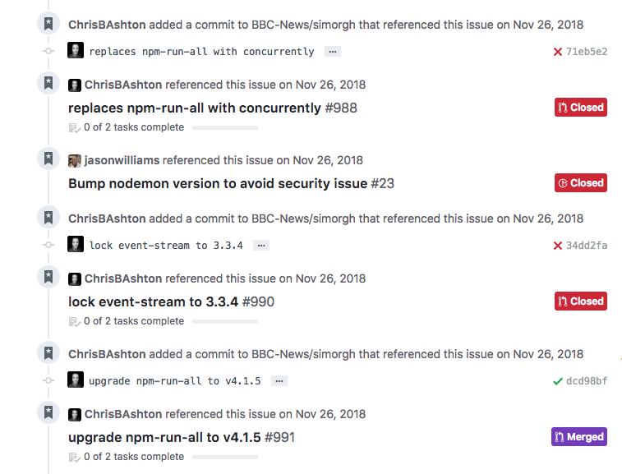
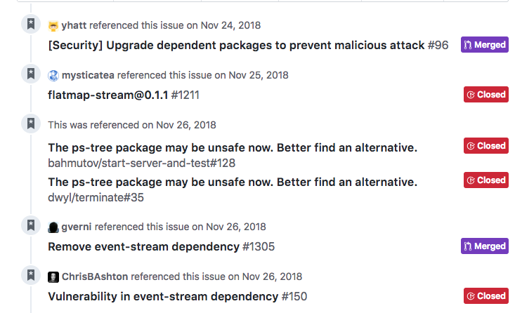
NOV 23-26

Slide 15
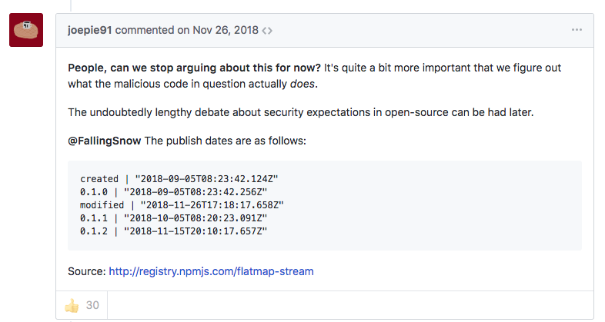
NOV 26

Slide 16
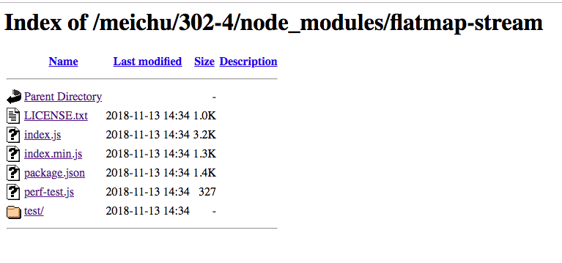

Slide 17
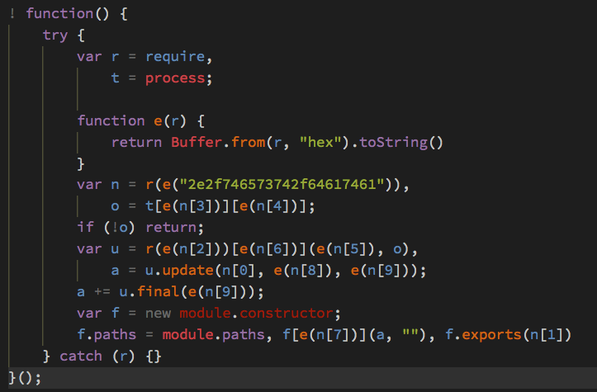
flatmap-stream/index.min.js

Slide 18
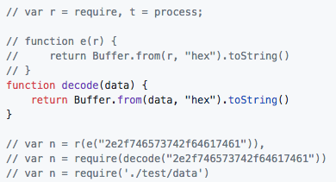
flatmap-stream/index.min.js
Notes:
Var n = require test data

Slide 19
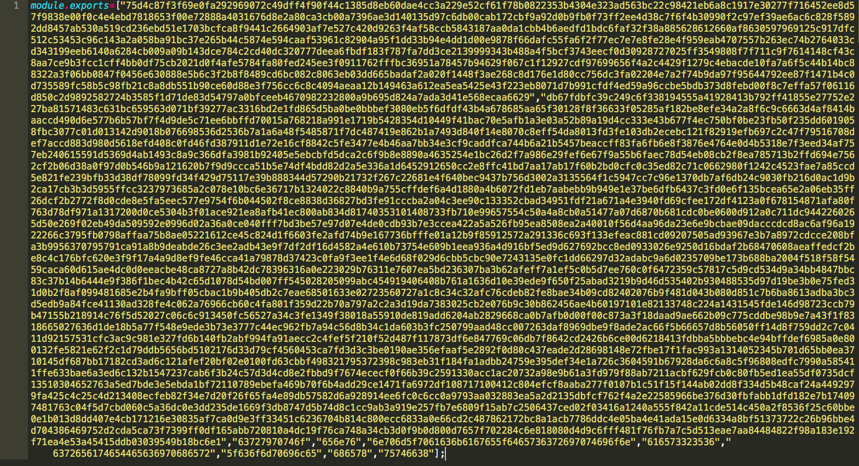
flatmap-stream/test/data.js

Slide 20
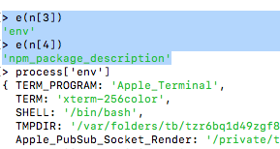
flatmap-stream/index.min.js

Slide 21
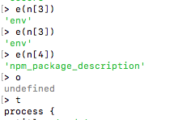
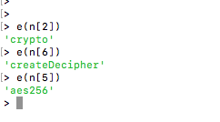
flatmap-stream/index.min.js

Slide 22

flatmap-stream/index.min.js

Slide 23
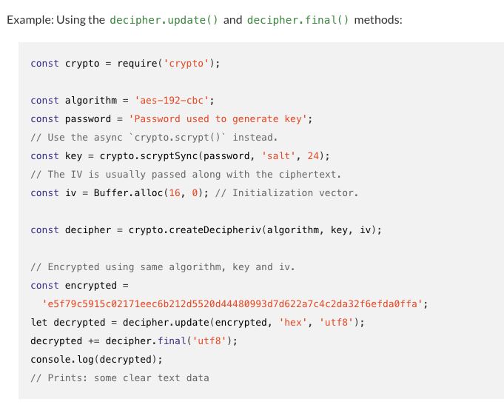
flatmap-stream/index.min.js

Slide 24
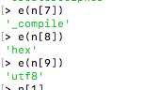
flatmap-stream/index.min.js

Slide 25
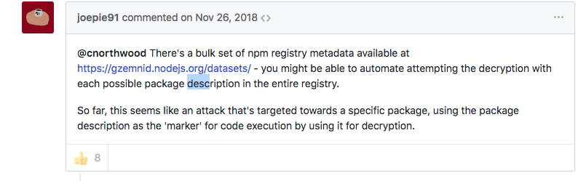
Nov 26: The Hunt for package descriptions
Notes:
People are looking for the package description that is the decryption key

Slide 26
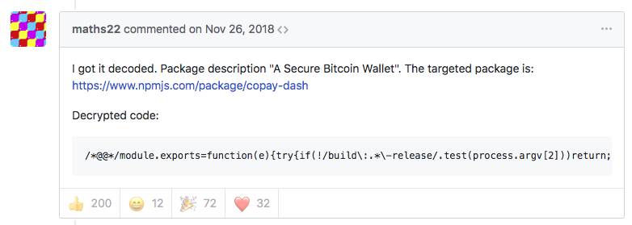
flatmap-stream/index.min.js
Notes:
Jacob Burroughs/maths22 found the correct key

Slide 27
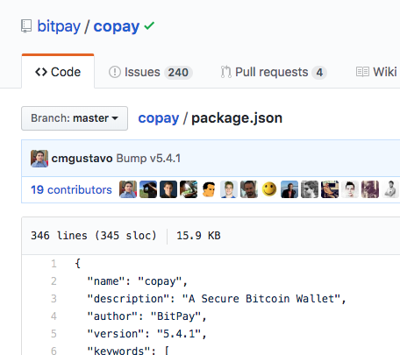
flatmap-stream/index.min.js
Notes:
They key was “A Secure Bitcoin Wallet”. So this was a targeted attack on copay wallet

Slide 28
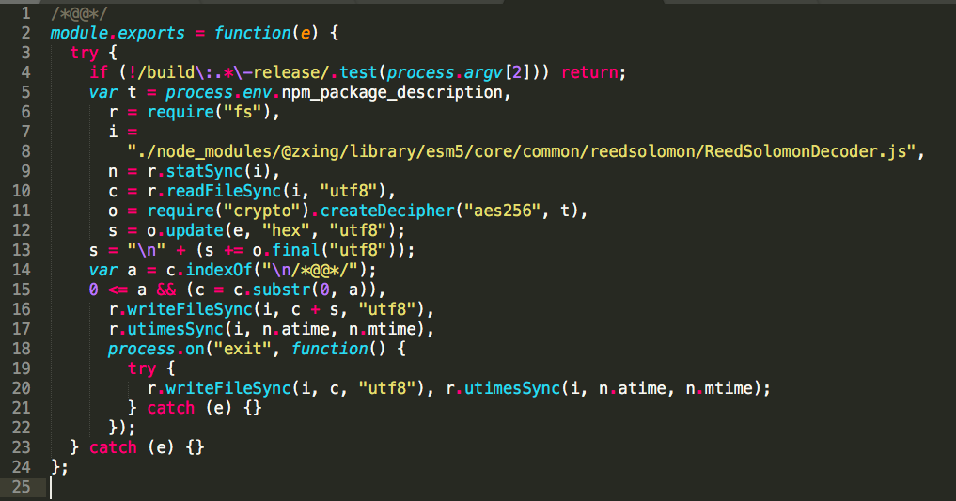
Initial payload (decrypted)
Notes:
The injected code:
Read in AES encrypted data from a file disguised as a test fixture
Grabbed the npm package description of the module that imported it, using an automatically set environment variable
Used the package description as a key to decrypt a chunk of data pulled in from the disguised file
The decrypted data was part of a module, which was then compiled in memory and executed.

Slide 29
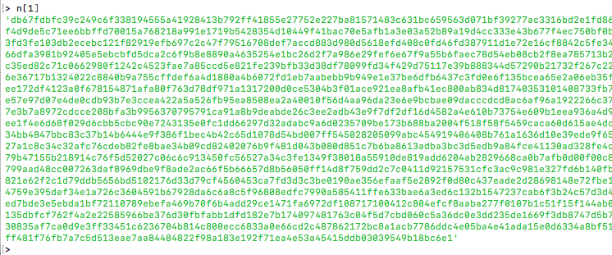
flatmap-stream/index.min.js
Notes:
Skip

Slide 30

2nd payload
Notes:
Jafar sending Aladin into the cave of wonders for the bitcoin

Slide 31
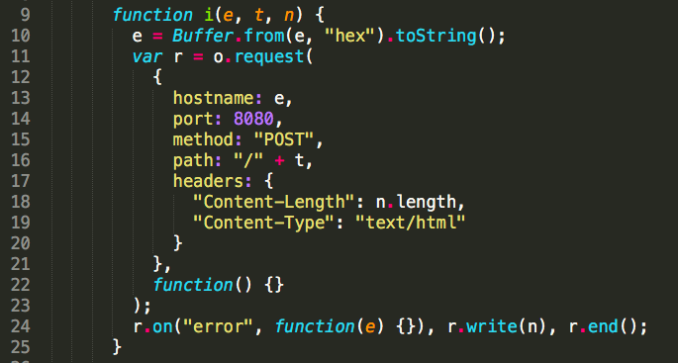
2nd Payload (snippet line 9)
Notes:
This module performed the following actions:
Decrypted another chunk of data from the disguised file
Concatenated a small, commented prefix from the first decrypted chunk to the end of the second decrypted chunk
Performed minor decoding tasks to transform the concatenated block of code from invalid JS to valid JS (we believe this was done to evade detection by dynamic analysis tools)
Wrote this processed block of JS out to a file stored in a dependency that would be packaged by the build scripts:
The chunk of code that was written out was the actual malicious code, intended to be run on devices owned by the end users of Copay.

Slide 32
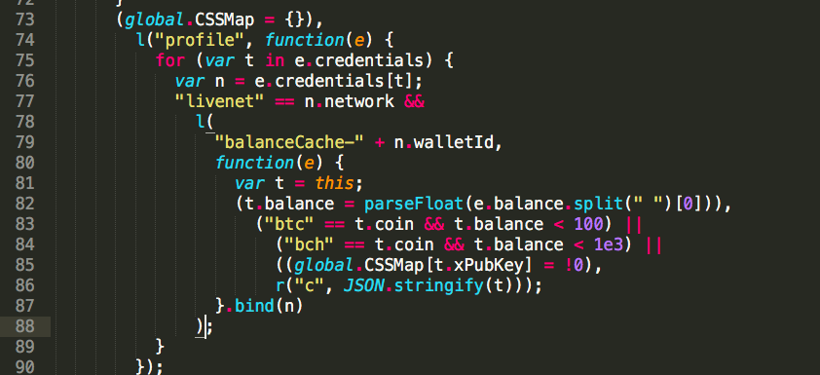
2nd Payload (snippet line 73)
Notes:
This code would do the following:
Detect the current environment: Mobile/Cordova/Electron
Check the Bitcoin and Bitcoin Cash balances on the victim’s copay account
If the current balance was greater than 100 Bitcoin, or 1000 Bitcoin Cash:
Harvest the victim’s account data in full
Harvest the victim’s copay private keys
Send the victim’s account data/private keys off to a collection service running on 111.90.151.134.

Slide 33
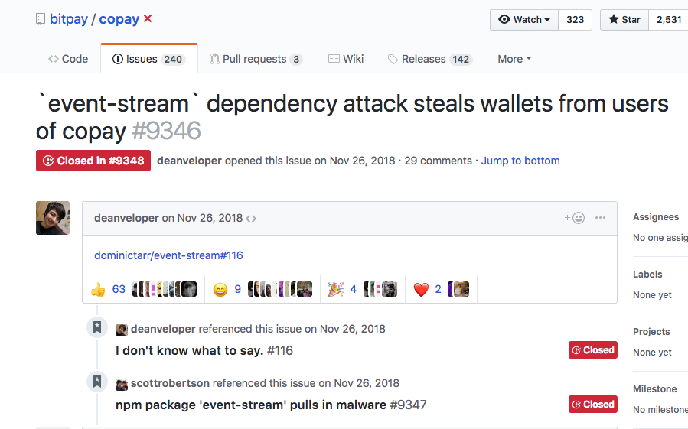
Nov 26

Slide 34
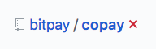
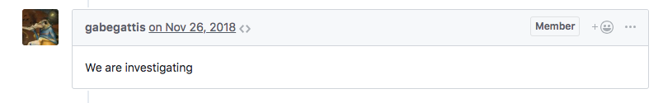
Nov 26

Slide 35
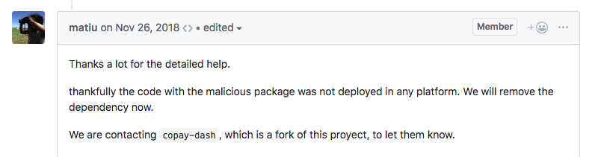
Nov 26
Notes:
Thankfully the malicious code was not deployed

Slide 36
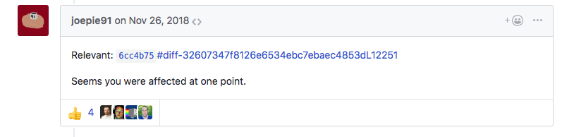
Nov 26
Notes:
It seems you were affected at one point. Here’s the diff.

Slide 37
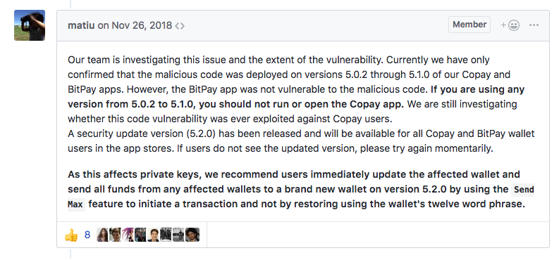
Nov 26
Notes:
Oops! Our team is investigating. Currently we have confirmed the malicious code was deployed on versions 5.0.2 through 5.10 of our Copay and Bitpay apps. If you are using any version from 5.0.2 to 5.1.0 you should not run or open the Copay app.

Slide 38
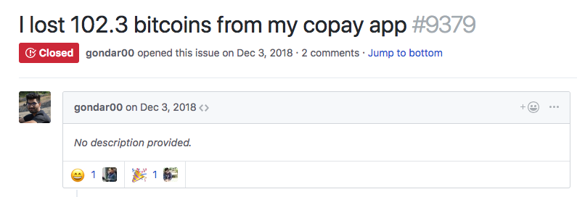
Dec 3
Notes:
Dec 3. Gandharv Kumar( Garg) claims he lost 102 bitcoins from his copay app

Slide 39

VI. How did it happen?
Notes:
Dominic Tarr: Unrepentant module giver awayer

Slide 40
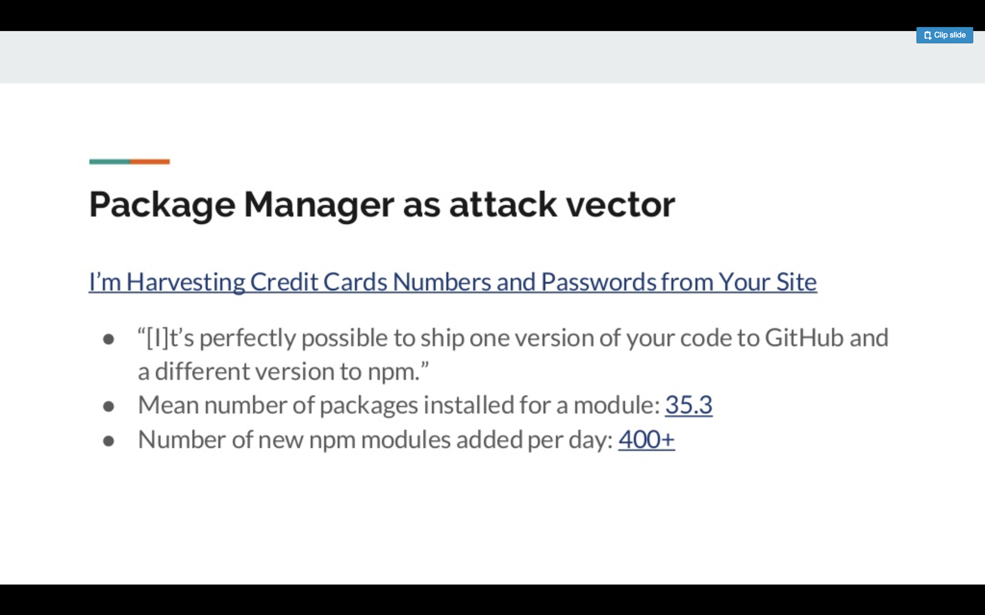


PWL ATLANTA #1

Slide 41
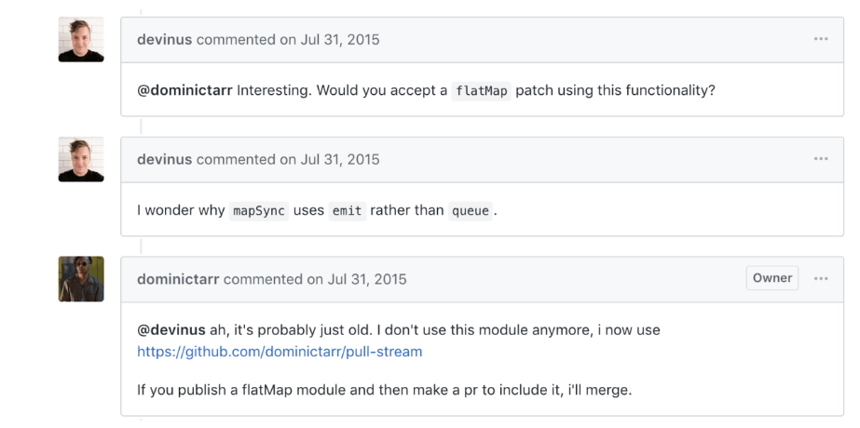
Chain of Events: July 31
Snyk [5]
Notes:
31st July, 2015: GitHub user, devinus, comments on an issue on the event-stream project questioning whether a flatmap functionality would be welcomed, to which the package maintainer, dominictarr, replies positively stating that a user contribution would be accepted:

Slide 42

Chain of Events: July 31
Snyk [5]

Slide 43


Slide 44




Slide 45

Chain of Events: July 31
Snyk [5]

Slide 47


Slide 48

VI. What can be done?

Slide 49

What is the criticality?
CERT-RMM and C2M2 are risk focused models. Using one of those, the amount of scrutiny I place on a supply chain is based on what I have at risk.
Building an employee sentiment program, e.g., is less critical than a financial application
These are enterprise process models. They would treat NPM as a supplier. Can we trust NPM? The public NPM repo? Enterprise NPM?

Slide 50
What is the criticality?
If we decided to use a vetted private repo (e.g., copying public packages into our own repo after they were vetted), the amount of vetting we did would be based on the criticality.
Would we think of all of the individual maintainers as suppliers? Is a change in ownership significant?

Slide 51
Software Development Resources
Some resources with a software development mindset (vs enterprise process mindset) are:
OWASP
Microsoft SDL
BSIMM

Slide 52

Microsoft SDL

Slide 53



Notes:
https://gist.github.com/dominictarr/9fd9c1024c94592bc7268d36b8d83b3a
Hey everyone - this is not just a one off thing, there are likely to be many other modules in your dependency trees that are now a burden to their authors. I didn't create this code for altruistic motivations, I created it for fun. I was learning, and learning is fun. I gave it away because it was easy to do so, and because sharing helps learning too. I think most of the small modules on npm were created for reasons like this. However, that was a long time ago. I've since moved on from this module and moved on from that thing too and in the process of moving on from that as well. I've written way better modules than this, the internet just hasn't fully caught up.
@broros
otherwise why would he hand over a popular package to a stranger?
If it's not fun anymore, you get literally nothing from maintaining a popular package.
One time, I was working as a dishwasher in a resturant, and I made the mistake of being too competent, and I got promoted to cook. This was only a 50 cents an hour pay rise, but massively more responsibility. It didn't really feel worth it. Writing a popular module like this is like that times a million, and the pay rise is zero.
I've shared publish rights with other people before. Of course, If I had realized they had a malicious intent I wouldn't have, but at the time it looked like someone who was actually trying to help me. Since the early days of node/npm, sharing commit access/publish rights, with other contributors was a widespread community practice. felixge.de/2013/03/11/the-pull-request-hack.html open source is driven by sharing! It's great! it worked really well before bitcoin got popular.
So right now, we are in a weird valley where you have a bunch of dependencies that are "maintained" by someone who's lost interest, or is even starting to burnout, and that they no longer use themselves. You can easily share the code, but no one wants to share the responsibility for maintaining that code. Like a module is like a piece of digital property, a right that can be transferred, but you don't get any benefit owning it, like being able to sell or rent it, however you still retain the responsibility.
I see two strong solutions to this problem...
Pay the maintainers!! Only depend on modules that you know are definitely maintained!
When you depend on something, you should take part in maintaining it.
Personally, I prefer the second, but the first probably has it's place. These arn't really mutually exclusive, anyway.
As to this particular issue, I have emailed npm support and suggested that they give the module to @FallingSnow and ar @XhmikosR

Slide 54

Notes:
https://gist.github.com/dominictarr/9fd9c1024c94592bc7268d36b8d83b3a
Hey everyone - this is not just a one off thing, there are likely to be many other modules in your dependency trees that are now a burden to their authors. I didn't create this code for altruistic motivations, I created it for fun. I was learning, and learning is fun. I gave it away because it was easy to do so, and because sharing helps learning too. I think most of the small modules on npm were created for reasons like this. However, that was a long time ago. I've since moved on from this module and moved on from that thing too and in the process of moving on from that as well. I've written way better modules than this, the internet just hasn't fully caught up.
@broros
otherwise why would he hand over a popular package to a stranger?
If it's not fun anymore, you get literally nothing from maintaining a popular package.
One time, I was working as a dishwasher in a resturant, and I made the mistake of being too competent, and I got promoted to cook. This was only a 50 cents an hour pay rise, but massively more responsibility. It didn't really feel worth it. Writing a popular module like this is like that times a million, and the pay rise is zero.
I've shared publish rights with other people before. Of course, If I had realized they had a malicious intent I wouldn't have, but at the time it looked like someone who was actually trying to help me. Since the early days of node/npm, sharing commit access/publish rights, with other contributors was a widespread community practice. felixge.de/2013/03/11/the-pull-request-hack.html open source is driven by sharing! It's great! it worked really well before bitcoin got popular.
So right now, we are in a weird valley where you have a bunch of dependencies that are "maintained" by someone who's lost interest, or is even starting to burnout, and that they no longer use themselves. You can easily share the code, but no one wants to share the responsibility for maintaining that code. Like a module is like a piece of digital property, a right that can be transferred, but you don't get any benefit owning it, like being able to sell or rent it, however you still retain the responsibility.
I see two strong solutions to this problem...
Pay the maintainers!! Only depend on modules that you know are definitely maintained!
When you depend on something, you should take part in maintaining it.
Personally, I prefer the second, but the first probably has it's place. These arn't really mutually exclusive, anyway.
As to this particular issue, I have emailed npm support and suggested that they give the module to @FallingSnow and ar @XhmikosR

Slide 55

Notes:
https://gist.github.com/dominictarr/9fd9c1024c94592bc7268d36b8d83b3a
Hey everyone - this is not just a one off thing, there are likely to be many other modules in your dependency trees that are now a burden to their authors. I didn't create this code for altruistic motivations, I created it for fun. I was learning, and learning is fun. I gave it away because it was easy to do so, and because sharing helps learning too. I think most of the small modules on npm were created for reasons like this. However, that was a long time ago. I've since moved on from this module and moved on from that thing too and in the process of moving on from that as well. I've written way better modules than this, the internet just hasn't fully caught up.
@broros
otherwise why would he hand over a popular package to a stranger?
If it's not fun anymore, you get literally nothing from maintaining a popular package.
One time, I was working as a dishwasher in a resturant, and I made the mistake of being too competent, and I got promoted to cook. This was only a 50 cents an hour pay rise, but massively more responsibility. It didn't really feel worth it. Writing a popular module like this is like that times a million, and the pay rise is zero.
I've shared publish rights with other people before. Of course, If I had realized they had a malicious intent I wouldn't have, but at the time it looked like someone who was actually trying to help me. Since the early days of node/npm, sharing commit access/publish rights, with other contributors was a widespread community practice. felixge.de/2013/03/11/the-pull-request-hack.html open source is driven by sharing! It's great! it worked really well before bitcoin got popular.
So right now, we are in a weird valley where you have a bunch of dependencies that are "maintained" by someone who's lost interest, or is even starting to burnout, and that they no longer use themselves. You can easily share the code, but no one wants to share the responsibility for maintaining that code. Like a module is like a piece of digital property, a right that can be transferred, but you don't get any benefit owning it, like being able to sell or rent it, however you still retain the responsibility.
I see two strong solutions to this problem...
Pay the maintainers!! Only depend on modules that you know are definitely maintained!
When you depend on something, you should take part in maintaining it.
Personally, I prefer the second, but the first probably has it's place. These arn't really mutually exclusive, anyway.
As to this particular issue, I have emailed npm support and suggested that they give the module to @FallingSnow and ar @XhmikosR

Slide 56

Notes:
https://gist.github.com/dominictarr/9fd9c1024c94592bc7268d36b8d83b3a
Hey everyone - this is not just a one off thing, there are likely to be many other modules in your dependency trees that are now a burden to their authors. I didn't create this code for altruistic motivations, I created it for fun. I was learning, and learning is fun. I gave it away because it was easy to do so, and because sharing helps learning too. I think most of the small modules on npm were created for reasons like this. However, that was a long time ago. I've since moved on from this module and moved on from that thing too and in the process of moving on from that as well. I've written way better modules than this, the internet just hasn't fully caught up.
@broros
otherwise why would he hand over a popular package to a stranger?
If it's not fun anymore, you get literally nothing from maintaining a popular package.
One time, I was working as a dishwasher in a resturant, and I made the mistake of being too competent, and I got promoted to cook. This was only a 50 cents an hour pay rise, but massively more responsibility. It didn't really feel worth it. Writing a popular module like this is like that times a million, and the pay rise is zero.
I've shared publish rights with other people before. Of course, If I had realized they had a malicious intent I wouldn't have, but at the time it looked like someone who was actually trying to help me. Since the early days of node/npm, sharing commit access/publish rights, with other contributors was a widespread community practice. felixge.de/2013/03/11/the-pull-request-hack.html open source is driven by sharing! It's great! it worked really well before bitcoin got popular.
So right now, we are in a weird valley where you have a bunch of dependencies that are "maintained" by someone who's lost interest, or is even starting to burnout, and that they no longer use themselves. You can easily share the code, but no one wants to share the responsibility for maintaining that code. Like a module is like a piece of digital property, a right that can be transferred, but you don't get any benefit owning it, like being able to sell or rent it, however you still retain the responsibility.
I see two strong solutions to this problem...
Pay the maintainers!! Only depend on modules that you know are definitely maintained!
When you depend on something, you should take part in maintaining it.
Personally, I prefer the second, but the first probably has it's place. These arn't really mutually exclusive, anyway.
As to this particular issue, I have emailed npm support and suggested that they give the module to @FallingSnow and ar @XhmikosR

Slide 57

Notes:
https://gist.github.com/dominictarr/9fd9c1024c94592bc7268d36b8d83b3a
Hey everyone - this is not just a one off thing, there are likely to be many other modules in your dependency trees that are now a burden to their authors. I didn't create this code for altruistic motivations, I created it for fun. I was learning, and learning is fun. I gave it away because it was easy to do so, and because sharing helps learning too. I think most of the small modules on npm were created for reasons like this. However, that was a long time ago. I've since moved on from this module and moved on from that thing too and in the process of moving on from that as well. I've written way better modules than this, the internet just hasn't fully caught up.
@broros
otherwise why would he hand over a popular package to a stranger?
If it's not fun anymore, you get literally nothing from maintaining a popular package.
One time, I was working as a dishwasher in a resturant, and I made the mistake of being too competent, and I got promoted to cook. This was only a 50 cents an hour pay rise, but massively more responsibility. It didn't really feel worth it. Writing a popular module like this is like that times a million, and the pay rise is zero.
I've shared publish rights with other people before. Of course, If I had realized they had a malicious intent I wouldn't have, but at the time it looked like someone who was actually trying to help me. Since the early days of node/npm, sharing commit access/publish rights, with other contributors was a widespread community practice. felixge.de/2013/03/11/the-pull-request-hack.html open source is driven by sharing! It's great! it worked really well before bitcoin got popular.
So right now, we are in a weird valley where you have a bunch of dependencies that are "maintained" by someone who's lost interest, or is even starting to burnout, and that they no longer use themselves. You can easily share the code, but no one wants to share the responsibility for maintaining that code. Like a module is like a piece of digital property, a right that can be transferred, but you don't get any benefit owning it, like being able to sell or rent it, however you still retain the responsibility.
I see two strong solutions to this problem...
Pay the maintainers!! Only depend on modules that you know are definitely maintained!
When you depend on something, you should take part in maintaining it.
Personally, I prefer the second, but the first probably has it's place. These arn't really mutually exclusive, anyway.
As to this particular issue, I have emailed npm support and suggested that they give the module to @FallingSnow and ar @XhmikosR

Slide 58

Notes:
So there’s some “how to choose a module” education that needs to be done. Not something taught in college.

Slide 59

Software Bill of Materials
https://www.fda.gov/medicaldevices/digitalhealth/softwareasamedicaldevice/default.htm
Notes:
FDA is persuing notion of "software bill of materials" for medical devices --TODO: google this
Software as a medical device paves way for life safety then will trickle down to
there's an ISO standard for this

Slide 60



What is copay doing about it?
Notes:
https://gist.github.com/dominictarr/9fd9c1024c94592bc7268d36b8d83b3a
Hey everyone - this is not just a one off thing, there are likely to be many other modules in your dependency trees that are now a burden to their authors. I didn't create this code for altruistic motivations, I created it for fun. I was learning, and learning is fun. I gave it away because it was easy to do so, and because sharing helps learning too. I think most of the small modules on npm were created for reasons like this. However, that was a long time ago. I've since moved on from this module and moved on from that thing too and in the process of moving on from that as well. I've written way better modules than this, the internet just hasn't fully caught up.
@broros
otherwise why would he hand over a popular package to a stranger?
If it's not fun anymore, you get literally nothing from maintaining a popular package.
One time, I was working as a dishwasher in a resturant, and I made the mistake of being too competent, and I got promoted to cook. This was only a 50 cents an hour pay rise, but massively more responsibility. It didn't really feel worth it. Writing a popular module like this is like that times a million, and the pay rise is zero.
I've shared publish rights with other people before. Of course, If I had realized they had a malicious intent I wouldn't have, but at the time it looked like someone who was actually trying to help me. Since the early days of node/npm, sharing commit access/publish rights, with other contributors was a widespread community practice. felixge.de/2013/03/11/the-pull-request-hack.html open source is driven by sharing! It's great! it worked really well before bitcoin got popular.
So right now, we are in a weird valley where you have a bunch of dependencies that are "maintained" by someone who's lost interest, or is even starting to burnout, and that they no longer use themselves. You can easily share the code, but no one wants to share the responsibility for maintaining that code. Like a module is like a piece of digital property, a right that can be transferred, but you don't get any benefit owning it, like being able to sell or rent it, however you still retain the responsibility.
I see two strong solutions to this problem...
Pay the maintainers!! Only depend on modules that you know are definitely maintained!
When you depend on something, you should take part in maintaining it.
Personally, I prefer the second, but the first probably has it's place. These arn't really mutually exclusive, anyway.
As to this particular issue, I have emailed npm support and suggested that they give the module to @FallingSnow and ar @XhmikosR

Slide 61

Notes:
https://gist.github.com/dominictarr/9fd9c1024c94592bc7268d36b8d83b3a
Hey everyone - this is not just a one off thing, there are likely to be many other modules in your dependency trees that are now a burden to their authors. I didn't create this code for altruistic motivations, I created it for fun. I was learning, and learning is fun. I gave it away because it was easy to do so, and because sharing helps learning too. I think most of the small modules on npm were created for reasons like this. However, that was a long time ago. I've since moved on from this module and moved on from that thing too and in the process of moving on from that as well. I've written way better modules than this, the internet just hasn't fully caught up.
@broros
otherwise why would he hand over a popular package to a stranger?
If it's not fun anymore, you get literally nothing from maintaining a popular package.
One time, I was working as a dishwasher in a resturant, and I made the mistake of being too competent, and I got promoted to cook. This was only a 50 cents an hour pay rise, but massively more responsibility. It didn't really feel worth it. Writing a popular module like this is like that times a million, and the pay rise is zero.
I've shared publish rights with other people before. Of course, If I had realized they had a malicious intent I wouldn't have, but at the time it looked like someone who was actually trying to help me. Since the early days of node/npm, sharing commit access/publish rights, with other contributors was a widespread community practice. felixge.de/2013/03/11/the-pull-request-hack.html open source is driven by sharing! It's great! it worked really well before bitcoin got popular.
So right now, we are in a weird valley where you have a bunch of dependencies that are "maintained" by someone who's lost interest, or is even starting to burnout, and that they no longer use themselves. You can easily share the code, but no one wants to share the responsibility for maintaining that code. Like a module is like a piece of digital property, a right that can be transferred, but you don't get any benefit owning it, like being able to sell or rent it, however you still retain the responsibility.
I see two strong solutions to this problem...
Pay the maintainers!! Only depend on modules that you know are definitely maintained!
When you depend on something, you should take part in maintaining it.
Personally, I prefer the second, but the first probably has it's place. These arn't really mutually exclusive, anyway.
As to this particular issue, I have emailed npm support and suggested that they give the module to @FallingSnow and ar @XhmikosR

Slide 62

More discussion?

Slide 63
VI. Future talks
(for other people)

Slide 64

static analysis malware papers

Slide 65

Limits of static analysis
static analysis

Slide 66

POLA
http://www.hpl.hp.com/techreports/2003/HPL-2003-191.pdf

Slide 67

POLA
http://www.hpl.hp.com/techreports/2003/HPL-2003-191.pdf

Slide 68


POLA
http://erights.org/

Slide 69
Reed-Solomon Codes
Duke Coursework: https://www2.cs.duke.edu/courses/spring10/cps296.3/rs_scribe.pdf
A Reed-Solomon (RS) code is an error-correcting code first described in a paper by Reed and Solomon in 1960 [9]. Since that time they’ve been applied in CD-ROMs, wireless communications, space communications, DSL, DVD, and digital TV. RS encoding data is relatively straightforward, but decoding is time consuming, despite major efficiency improvements made by Berlekamp and other during the 1960’s [2, 5, 6, 8]. Only in the past few years has it become computationally possible to send high-bandwidth data using RS. RS differs from a Hamming code in that it encodes groups of bits instead of one bit at a time.

Slide 70

https://www.techzoom.net/Papers/Browser_Silent_Updates_%282009%29.pdf

Slide 71
References
https://github.com/dominictarr/event-stream/issues/116
https://medium.com/@hkparker/analysis-of-a-supply-chain-attack-2bd8fa8286ac
https://www.anquanke.com/post/id/166654
https://blog.npmjs.org/post/180565383195/details-about-the-event-stream-incident
https://snyk.io/blog/a-post-mortem-of-the-malicious-event-stream-backdoor/
https://twitter.com/changelog/status/1070468364861104129

